Slide 1


Digital Twin Monitoring System

Slide 2








Introduction
The SPoHF project
Partners
Digital twin
Fontys

Slide 3
Monitoring
Lightning Monitoring
Climate Monitoring
Insect Monitoring
Digital Twin
Prescriptive Twin
Weather Monitoring
Soil Analisys
Predictive Twin

Slide 4

Solution: The Digital Twin Monitoring System
Problem
How do we know its working?
How do we know when there is a problem?
How do we what consequences a problem has?

Slide 5
Project scope
The project will:
The project will not:
Monitor Digital Twin
Monitor the hardware
Show system failures
Show consequences of failures
Update in real time.
Give notifications
Help solve problems

Slide 6
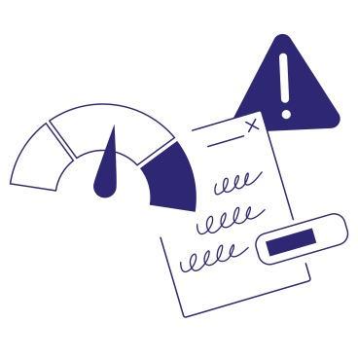
Risks
1
Unfinished application
Insufficient hardware
Impact
2
Probability

Slide 7

Stakeholders
Name | Company | Influence | Impact | Role
Budurovici Razvan | Fontys | High | High | Integrates insect counting
Gregory Schwake | Fontys | High | High | Project Manage
Tim Riebner | Proc evolution | High | High | Customer representative
Cristiane Salz | Fontys | Low | Low | Develops insect counting
Joel Eckhardt | Fontys | Low | High | Designs the General Interface

Slide 8
Introduction
Product Backlog
Tool Selection
High level overview
Design environment
Implementation
3W
Rollout
1W
2W
1W
2W
9W
3W
31/01
04/09
25/09
02/10
16/10
24/10
07/11
10/01
2024

Slide 9
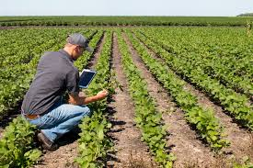
Analysis
Interviews
Insect counting interview
Customer interview
Compass agro visit

Slide 10

User stories
Developer
Manager
Both
Hardware monitoring
See traces
Error messages
See last 4 weeks
Web interface
Real time information
Management interface

Slide 11

Tool selection
What do we need the tools for:
Monitoring visualization
Hardware monitoring
Monitoring data storage

Slide 12
Criteria
General:
Ecosystem
Free of cost
Works with other tools
Wildcard
Hardware monitoring
Basic hardware monitoring
Visualization
Web display
Real time display
Display features
Data storage
4-week storage
Time series

Slide 13
Criteria example: Ecosystem
Based on stars on GitHub:
5 points 40.000+ stars
4 points 30.000-40.000 stars
3 points 20.000-30.000 stars
2 points 10.000-20.000 stars
1 point 5.000-10.000 stars
0 points 0-5.000 stars
Based on the activity rating on Libhunt:
5 points 9-10 score
4 points 7-9 score
3 points 5-7 score
2 points 3-5 score
1 point 1-3 score
0 points 0-1 score

Slide 14
Results monitoring data storage
Name | Good ecosystem | Works with other tools | Wildcard | Total
Prometheus | 10 | 6 | 2 | 18
Timescale DB | 7 | 3 | 1 | 11
Quest DB | 7 | 0 | 0 | 7
Influx DB | 8 | 3 | 0 | 11

Slide 15
Results hardware monitoring
Name | Good ecosystem | Works with other tools | Wildcard | Total
Prometheus Node Exporter | 6 | 3 | 2 | 11
Telegraph | 7 | 3 | 0 | 10
Zabbix | 6 | 3 | 0 | 9

Slide 16
Results monitoring visualization
Name | Good ecosystem | Works with other tools | Display features | Wildcard | Total
Grafana | 10 | 3 | 10 | 2 | 25
Apache Superset | 10 | 3 | 7 | 0 | 21
Metabase | 9 | 3 | 6 | 0 | 18

Slide 17

Results
Selected tools:
Prometheus
Prometheus node exporter
Grafana

Slide 18
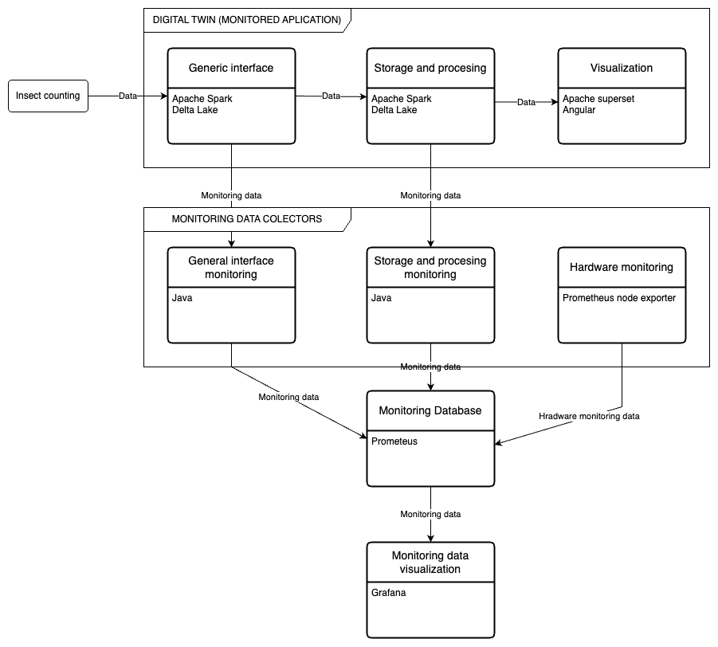

High-level
overview
Apache pulsar

Slide 19



Environment set-up

Slide 20
ID | Name | Goal
1 | Hardware Monitoring | An interface showing hardware monitoring data.
2 | Error Monitoring | An interface showing errors and warnings.
3 | Trace Monitoring | An interface showing traces
4 | Management interface | An interface understandable by those without in depth technical knowledge.
Sprint organization

Slide 21
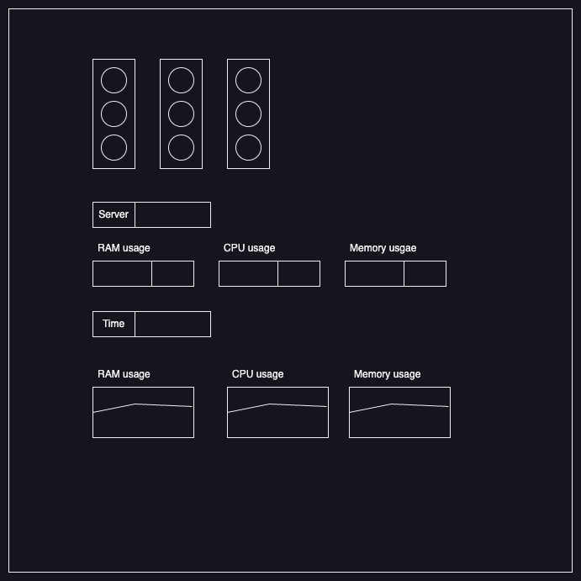
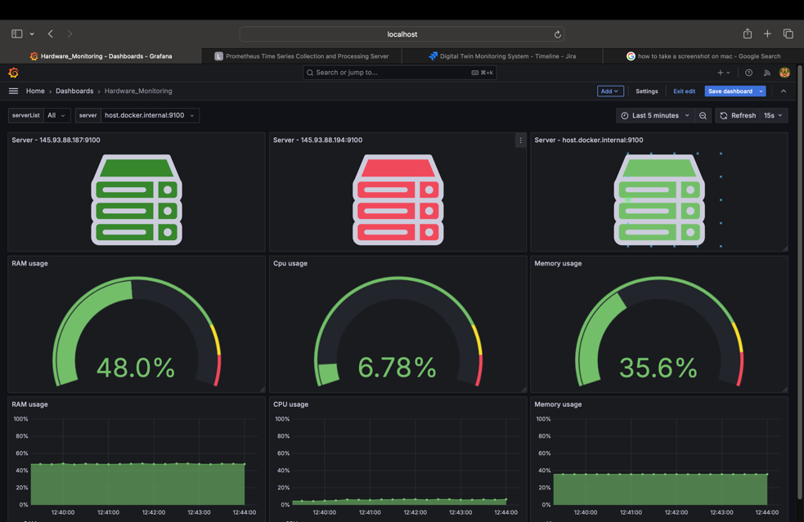
Sprint 1: Hardware Monitoring

Slide 22


Sprint 2: Error monitoring
Problem: Prometheus is not fit for Logs
Solution: Use Loki
Made by Grafana
Molded after Prometheus
Comes with Promtail

Slide 23
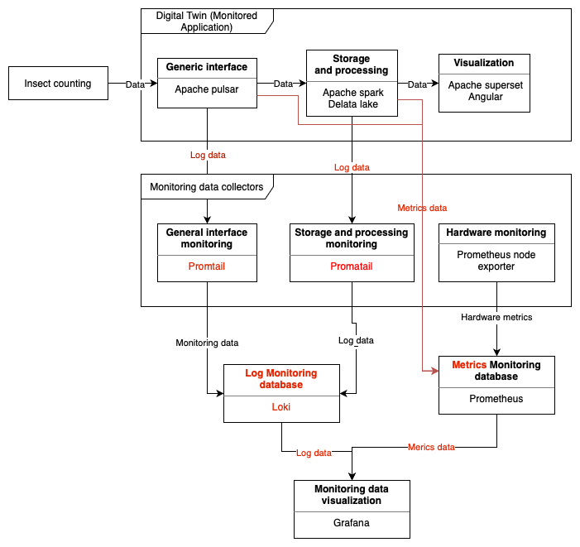
Updated High-level
overview

Slide 24
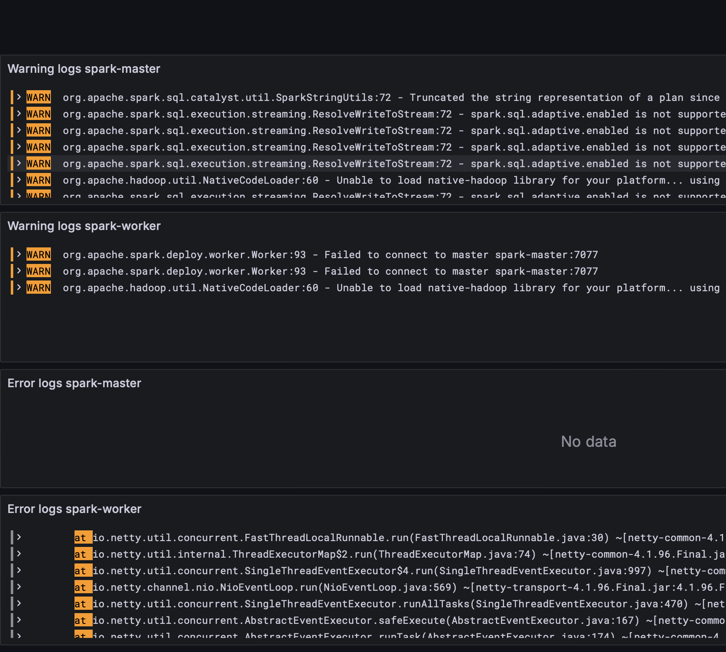
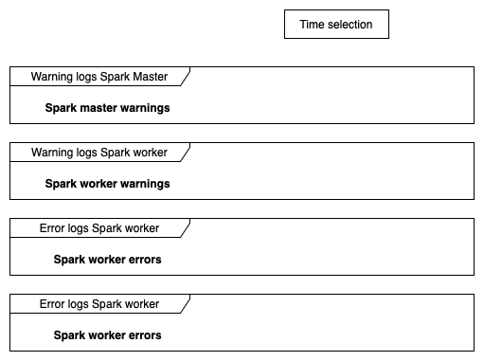
Sprint 2: Error monitoring
Master

Slide 25
Sprint 3: Trace monitoring
Problem: It is impossible to monitor distributed traces of Apache Spark without modifying the monitored application.

Slide 26
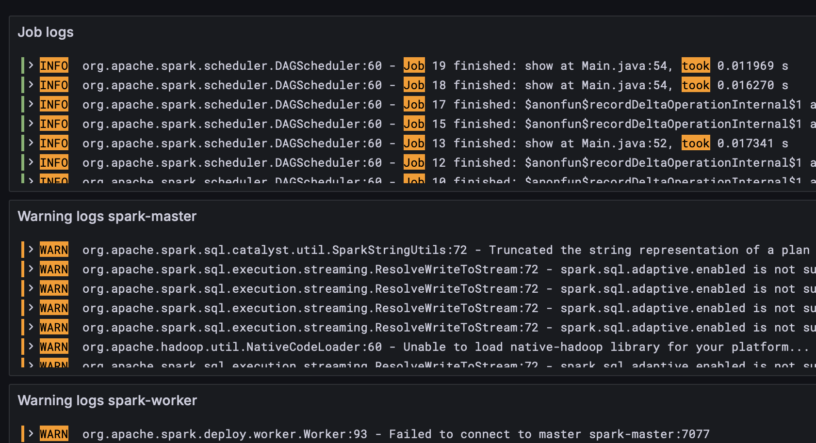
Sprint 3: What was implemented instead
Added monitoring of completion and duration of spark jobs
Made the databases only store 4 weeks of data
Linked the two dashboards

Slide 27
Conclusion
The application can:
Monitor metric and log data from Digital Twin.
Display the data trough a web interface.
Show up to 4 weeks of data.
Show changes within 10 seconds of them happening.
The application is not yet able to:
Show trace data
Have a management Interface
Monitor all of Digital Twin (doesn’t monitor the General Interface)

